Slide 1

Face to face workshop
29 Sept 2016

Slide 2
9/29/2016 F2F Workshop Agenda
(Page 1 of 2)
Time | Topic | Presenter/Facilitator
08:30 – 09:00 | Introduction and Key Note | Neal Ziring, MPO
 | Prototype Implementations
09:00 - 9:05 | Overview | Joyce Fai, General Dynamics
9:05 - 09:35 | OpenC2 Actions as Multi-methods | Joshua Brule, University of MD
09:35 – 09:50 | Deny at Perimeter | Larry Salazar, General Dynamics
09:50 – 10:05 | OpenC2 as a Supported Data Model in Cisco Threat INTEL API | Jyoti Verma, Cisco
10:05 – 10:30 | NSA/ APL Host based Implementation | Kevin Miller, MPO
10:30 – 10:45 | Break
10:45 – 11:30 | OpenC2 and Distributed Network Security Policy Convergence | Eric Voit, Cisco
11:30 – 12:00 | Schema Design | Dave Kemp, MPO
12:00 – 12:30 | Working Lunch

Slide 3
9/29/2016 F2F Workshop Agenda
(Page 2 of 2)
Time | Topic | Presenter/Facilitator
 | Implementation Considerations
12:30 – 13:30 | Lessons and Implementation Considerations | Group Discussion; Facilitated by Joe Brule (MPO) and Jason Romano (GD)
13:30 – 1400 | Implementing Structured COA for STIX Version 2.X | Jyoti Verma, Cisco Bret Jordan, Bluecoat
 | Way Forward
14:00 – 15:00 | What is the next REALLY Hard Problem | Group Discussion
15:00 – 15:15 | Break
15:15 – 15:25 | OASIS Overview | Bret Jordan, Bluecoat
15:25 – 16:00 | Path to Standardization | Group Discussion
16:00 – 16:45 | Way Forward for OpenC2 | Group Discussion
16:45 – 17:00 | Wrap Up | Joe Brule, MPO
17:00 | Adjourn

Slide 4
Quarterly face to face workshop FALL 2016
Neal Ziring
Technical Director,
NSA Capabilities Directorate
29 SEP 2016

Slide 5
Agenda
Background
Motivation
Status
Way Forward
Implementation Considerations
Reference Implementations
Actuator Profiles
Path to Standardization
Future of the OpenC2 Forum

Slide 6
The Motivation and Vision
Future Cyber Defense Tactics:
Sharing of indicators
Coordination of response actions
Automated, multi-part actions at machine speed
OpenC2 Forum
Identify and fill gaps as they pertain to command and control for the provision or support of cyberdefense
Create a diverse and collaborative environment.
Standardization is a Key Enabler for Unambiguous C2
Notes:
Highlight that the responses need to be coordinated and that standards based solutions will facilitate integration

Slide 7
OpenC2 ‘Philosophy’
UNCLASSIFIED
Pre-existing standards will be leveraged to the greatest extent practical
Minimize Complexity of Command
Minimize Overhead on Sensor/Actuator
Facilitate Adoption
Infrastructure, architecture, and vendor agnostic
Extensible to support different levels of detail and future technologies
UNCLASSIFIED

Slide 8
OpenC2 Design Principles
UNCLASSIFIED
Lightweight Efficient Machine-to-Machine communications
Abstract
Focuses on ‘What’ to do vice ‘Device Specific’
Permits different levels of commanding
Extensible
Enables additional precision and flexibility
Agnostic
e.g., Transport, Authentication, Integrity controls
Enables flexibility w.r.t. implementation
Enable Unambiguous Machine-to-Machine
Command and Control Messages
UNCLASSIFIED

Slide 9
Status/ Recently Posted
Version 1.0 of the Language Description Document
Posted on OpenC2.org
Define Actions, Syntax and Modular Data Model
Version 1.0 of the IA Considerations Document
STIX sub-working group
OpenC2 to be included in STIX 2.1
Collaboration with STIX WG
Draft SDN Profile posted
OpenC2 Schema in process
Draft JSON encoded version posted on OpenC2.org
ASN.1 version in progress
Notes:
We converged on about 30 actions and are using the cybox objects to provide the data model for the targets. The data model for the actuators is still in process, for now using an OpenC2 defined model
CISCO is leading the effort to work with OASIS. Jyoti will give us an update later today
SPAWAR had done some remarkable work on an SDN overlay and Randy will provide an overview later this morning

Slide 10
Works In Progress
Prototype Implementations
Multiple Efforts from government, industry, and academia
Capturing Lessons Learned
Modify Language Description Document
Identify/ Prioritize Next Steps
Expand Documentation
Implementation Considerations
Annexes to Language Description Document
More Conspicuous Public Presence
Presented at multiple forums
Expanded Public facing website
Guests present at Face to Face
Notes:
The definition of the use cases and work on the language itself is still in progress. The reference implementations will help us identify shortcomings and direct future efforts.
The current efforts will be presented and discussed through lunch today
We are currently working with NIST’s CCOE to provide use cases and requirements for OpenC2.

Slide 11
Next Steps
Refine Documentation
Transition from Prototype to Reference Implementation
Approach NIST Cyber-security Center of Excellence
Academia
Gather Use Cases From Stakeholders
Actuator Profiles
Next ‘Hard’ Problem?
Path To Standardization
OASIS
IETF
ISO
Other?
Future Direction of The OpenC2 Forum
Notes:
This group has grown and matured enough to allow us to expand our efforts. The work on the language and the use cases will continue, but we need to identify additional functionality needed and determine which can be treated as external dependencies and where we need to expand the protocol.
The next ‘big’ effort will be the IA overlay.

Slide 12

UNCLASSIFIED
OpenC2 Standardization Timeline
FY
Q1 16
Q2 16
Q3 16
Q4 16
Q1 17
Q2 17
OpenC2 Definition
WG Definition Containers
STIX COA
Workflows
Message Fabric
External Dependencies
Data Models
Actuator (e.g., OpenC2, SACM)
Target (CyBox)
Language Description Document
Actions, Syntax
Use Cases
Gaps in language and data models
Reference Implementations (exercise/stretch the language)
Usage Scenarios
Pub/Sub, Perimeter Defense
Software Defined Network
COTS-based SHORTSTOP
Full Mesh, Sensors
Internet of Things
GitHub Repository
Reference Code
OpenC2 Connectors
Data Model Encoding and Translation Tools
OpenC2 Connectors
Adoption
(vendor and mission buy-in)
Vendor
Orchestrators
Actuators
OpenC2 Connectors
Native Support
Early Adopters
Cisco Threat INTEL API (CTIA), TCS
Standard (Revs)
Standards Bodies
NIST National CyberSecurity COE (OpenC2 Reference Design)
Socialization and Onboarding
Submit Draft Language Description Document to OASIS or other recognized Standards Body
UNCLASSIFIED

Slide 13
Goals For Today
Prototype Efforts
Capture Lessons Learned
Identify and Address Issues
Create Reference Implementation
Implementation Documentation
Identify External Dependencies
Message Fabric Considerations
Define Way Forward for Standardization
Define Future Role of OpenC2 Forum

Slide 14
Questions?

Slide 15
Prototype Implementations

Slide 16
Overview
Joyce Fai

Slide 17
OpenC2 Deployment Environments

Slide 18
OpenC2 Abstract Syntax
(
action = <ACTION_TYPE>,
target (
type = <TARGET_TYPE>,
<target-specifier>
),
actuator (
type = <ACTUATOR_TYPE>,
<actuator-specifier>
),
modifiers (
<list-of-modifiers>
)
)

Slide 19
Documentation in Process
OpenC2 Language Description Document Ver. 1.0
GitHub: openc2-org/language-description
openc2.org: public link
Solicit comments from nonmembers?
Comment Resolution circa January 2017?
IA Considerations Document Ver. 1.0
GitHub: openc2-org/security
openc2.org: public link
Comments/ resolution from nonmembers?
JSON Schema
GitHub: openc2-org/schemas/json

Slide 20
Prototype Implementations
Current/ Pending Efforts
SDN Controller (Joint SPAWAR, University of Maryland)
Subnet Deny, Mitigate, Set, Query
Perimeter Firewall (Joint NSA, Phantom Cyber, Cisco)
Intra-domain Deny, Mitigate
Cisco Threat Intelligence API
Cisco ASA interfacing with CTIA
NSA/APL Host based Implementation
Intra-domain OpenC2 commands
OpenC2 and Distributed Network Security Policy Convergence
Update documents based on findings

Slide 21
29 September OpenC2 Face to Face Prototype Implementations - Composite
Orchestrator 2
Phase 1:
Orchestrator 1
Phase 2:
OpenC2 Proxy
OpenC2 [JSON] (mitigate)
Generator
OpenC2 [JSON] (deny)
Consumer
Block
Palo Alto
Video Source
Consumer
Generator
Consumer
Video Destination 1
Video Destination 2
OpenC2 [JSON] (deny)
Mitigation Manager (SDN Controller)
OpenFlow
Demonstration:
Deny at the Perimeter
Software Defined Networks
Cisco Threat Intel
Consumer
A
OpenC2 [JSON] (deny)
OpenC2 Proxy
deny
Cisco ASA
Consumer

Slide 22
OpenC2 Actions as Multi-methods
Joshua Brule

Slide 23
Deny at Perimeter
Larry Salazar

Slide 24
Cisco Threat Intelligence API and OpenC2
Jyoti Verma

Slide 25
Cisco Threat Intelligence API and OpenC2
Orchestrator 1
CTIA COA(deny)
OpenC2 Proxy
IP Blacklist
Cisco ASA
Producer
Consumer
IP Whitelist
Client
Server
COA store
Demonstration:
Use Cisco Threat Intelligence Service to share actionable threat intel
Based on threat intel, determine that action Send an OpenC2 Deny from Orchestrator 1 Producer to OpenC2 proxy (RESTful API)
OpenC2 proxy consumes Deny and sends CISCO ASA command
OpenC2 Modifier: duration
Deny ACL is programmed on the Cisco ASA for the duration of the command
https://github.com/threatgrid/ctia
https://github.com/threatgrid/ctim/blob/master/src/ctim/schemas/coa.cljc

Slide 26
NSA/APL Host based Implementation
Kevin Miller

Slide 27
OpenC2 and Distributed Network Security Policy Convergence
Eric Voit

Slide 28
Schema Design
Sept 2016
Dave Kemp -- NSA, IA Architectures & Mission Applications

Slide 29
Schema
A schema is:
Generic: a structured framework or plan
Database: the structure of a database system, described in a formal language that defines the tables, the fields in each table, and the relationships between fields and tables
XML/JSON: a description of the elements in a document that can be used to validate each piece of content
A schema can be:
abstract or concrete
formal (written in a syntax definition language) or informal

Slide 30
Abstract Syntax*
An Abstract Syntax Language is:
A formal language for specifying the logical structure of data that is to be exchanged between two endpoints
independent of hardware platform, operating system, programming language, local representation, etc.
Standard sets of rules for encoding instances of logical data structures that are specified in abstract notation
for the purpose of transmission
* Description and Principles by Allesandro Trigila
http://www.ieee802.org/802_tutorials/2010-11/
Describes ASN.1, but applies to any abstract syntax language

Slide 31
Principles and Benefits* of abstract syntax
Separation of concerns
The description of the logical structure of a message is kept completely separate from the details of the encoding
Message descriptions are machine-processable
This enables the creation and use of software development tools and testing tools that can read and understand the formal definitions
Encodings are standardized
The problem of specifying detailed encodings and the problem of encoding/decoding messages and their fields do not need to be addressed again and again
Extensibility
It is possible to extend a message description in controlled ways while ensuring backward- and forward-compatibility between different version implementations

Slide 32

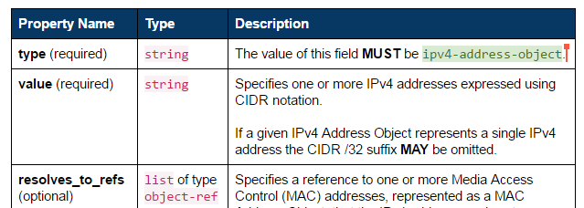
OASIS CTI Data Definitions
STIX, TAXII, CybOX are specified in Property Tables
Abstract description
Independent of serialization (XML, JSON, binary)
Informal definition of data objects
Cannot be machine parsed, validated, or translated
Interim step toward formal abstract specifications
Would enable automated translation to concrete schemas:
XSD
JSON Schema
Proto3
…

Slide 33
OpenC2 Data Definitions
Current implementation: Python abstract data structures
Executable: enables encoding- independent message validation
Defines OpenC2 abstract syntax
Unambiguous type checking
Validates example messages
Supports multiple message formats
JSON (multiple dialects)
XML
Binary
Corresponds directly to informal property tables and formal abstract syntax
class OpenC2Command(Record): vals = [ ('action', Action, ''), ('target', Target, ''), ('actuator', Actuator, '?'), ('modifiers', Modifiers, '?')]
class Action(Enumerated):
vals = [
'scan', # 1
'locate', # 2
'query', # 3
...
'remediate'] # 35
class Target(Record):
vals = [
('type', TargetTypeValue , ''),
('specifiers', cybox.CyboxObject,
'?,{type}')]

Slide 34
Abstract Syntax - Structures
JSON Data Model
Array – ordered list of items
Item has position, no name
Object – unordered set of properties
Property has name, no position
Abstract Data Model
Record – ordered list of fields
Field has both name and position
Encoded in JSON as either Array or Object
Decoder restores names to Array fields, positions to Object fields
Map – unordered set of fields
Field has name, no position
Encoded in JSON as Object
class OpenC2Command(Record): vals = [ ('action', Action, ''), ('target', Target, ''), ('actuator', Actuator, '?'), ('modifiers', Modifiers, '?')]

Slide 35
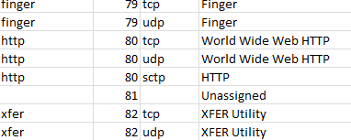
Abstract Syntax – Names
JSON Data Model
Names transmitted as strings
Field names / property keys (e.g., “type”, “value”, “Action”)
Literals in a vocabulary (e.g., “ipv4-address-object”, “TCP”, “scan”)
Abstract Data Model
Names transmitted as either strings or tags
Tags (ElementIDs) assigned to Names in a registry
Example - port numbers:
class Action(Enumerated):
vals = [
'scan', # 1
'locate', # 2
'query', # 3
...
'remediate'] # 35

Slide 36
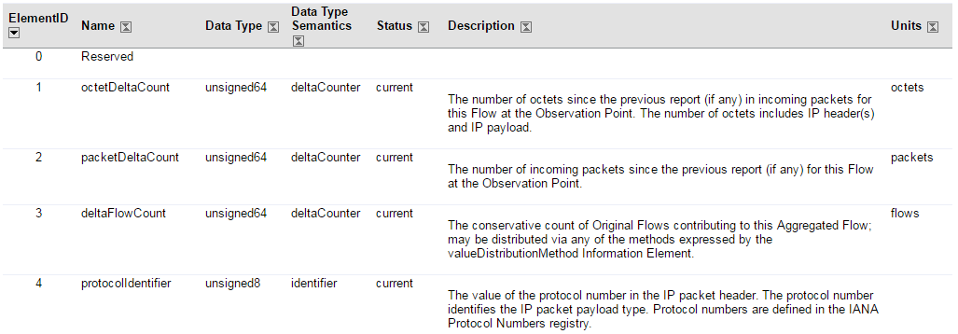
Abstract Syntax – Names (cont.)
IP Flow Information Export (IPFIX) element registry
Abstract syntax assigns IDs (1) to names (“octetDeltaCount”)
Concrete encoding uses one or the other
Decoder supplies name corresponding to received ID
Namespace used to identify registry

Slide 37
JSON Abstract Syntax Notation (JASN)
JSON document that defines an abstract schema
Import directly by applications, or
Translate to concrete schemas used by applications
Two sections:
- config information
- datatype definitions
Definitions:
- datatype, base type, options
Fields:
- position (ordinal) or tag
- field name
- datatype
- options
{
"meta": {
"module": "openc2"
},
"types": [
["OpenC2Command", "Record", "", [
[1, "action", "Action", ""],
[2, "target", "Target", ""],
[3, "actuator", "Actuator", "?"],
[4, "modifiers", "Modifiers", "?"]
]]
]
}

Slide 38
Abstract Schema Representations
{
"meta": {
"module": "openc2"
},
"types": [
["OpenC2Command", "Record", "", [
[1, "action", "Action", ""],
[2, "target", "Target", ""],
[3, "actuator", "Actuator", "?"],
[4, "modifiers", "Modifiers", "?"]
]]
]
}
JSON Load
JSON Dump
Abstract Syntax
JASN
OpenC2Command ::= SEQUENCE {
action Action,
target Target,
actuator Actuator OPTIONAL,
modifiers Modifiers OPTIONAL
}
Tag | Prop | Type
1 | action | String
2 | target | TargetType
3 | actuator | ActuatorType
4 | modifiers | ModifiersType
OpenC2Command ::= RECORD {
action Action,
target Target,
actuator Actuator OPTIONAL,
modifiers Modifiers OPTIONAL
}
ASN.1
class OpenC2Command(Record):
ns = "openc2"
vals = [
("action", Action, ""),
("target", Target, ""),
("actuator", Actuator, "?"),
("modifiers", Modifiers, "?")]
Property Tables
PseudoASN
Python Classes

Slide 39
Pseudo-ASN (PASN)
Mostly ASN.1, but modified for ease of use
ASN.1 has no first-class map (key:value pair) type
SEQUENCE / SEQUENCE OF and SET / SET OF are the only compound ASN.1 types
Table Constraint syntax is general but cumbersome
PASN defines MAP to represent Identifier:Typereference pairs
ASN.1 restricts case for Identifier and Typereference
PASN allows both upper and lower case first character
ASN.1 SEQUENCE does not support encoding modes
JSON Encoding Rules (to be defined) might add encoding modes
PASN defines RECORD to be encoded as either JSON object or array
PASN requires explicit tags for names
RECORD field tags are optional, must be ordinal if present
PASN does not allow anonymous type definitions
Fields contain references to named types
Supports direct translation to JASN without compiling

Slide 40
JSON Encoding Modes
Verbose
RECORD encoded as Object
Highest bandwidth
Arguably most human-readable (explicit field names)
Concise
RECORD encoded as Array
Reduced bandwidth
Arguably more readable (no field name clutter)
Minimized
RECORD encoded as Array, Names encoded as Tags
Most bandwidth efficient, least readable
Use directly for transmission, or as visualization of binary encoding

Slide 41
Concrete Schema Generation
{
"meta": {
"module": "openc2"
},
"types": [
["OpenC2Command", "Record", "", [
[1, "action", "Action", ""],
[2, "target", "Target", ""],
[3, "actuator", "Actuator", "?"],
[4, "modifiers", "Modifiers", "?"]
]]
]
}
JSON Load
JSON Dump
Abstract Syntax
API (Application Programming Interface)
JASN
JSON Schema Verbose
JSON Schema Concise
JSON Schema Minimized
XSD
Proto3 Binary
Other Binary
[34,[8,["cdn.badco.org"]]]
["mitigate",["cybox:Hostname",["cdn.badco.org"]]]
{"action":"mitigate","target":{"type":"cybox:Hostname","specifiers":{"Hostname_Value":"cdn.badco.org"}}}
Encoding (Message Formats)

Slide 42

Application Development
{
"meta": {
"module": "openc2"
},
"types": [
["OpenC2Command", "Record", "", [
[1, "action", "Action", ""],
[2, "target", "Target", ""],
[3, "actuator", "Actuator", "?"],
[4, "modifiers", "Modifiers", "?"]
]]
]
}
Tag | Prop | Type
1 | action | String
2 | target | TargetType
3 | actuator | ActuatorType
4 | modifiers | ModifiersType
OpenC2Command ::= RECORD {
action Action,
target Target,
actuator Actuator OPTIONAL,
modifiers Modifiers OPTIONAL
}
Create PASN schema based on standard specs
Translate
Property Tables
PseudoASN
JASN
Dynamic Load
Orchestrator
Producer
Consumer
Actuator
OpenC2
(deny)
JSON or Binary
API (Application Programming Interface)
Encoding (Message Formats)

Slide 43
Message Structure
API supports structure (nested objects) and template (object with path keys) formats
Identical information, lossless bidirectional conversion
Template format may be easier for applications to work with
{ "ACTION": "DENY",
"TARGET": {
"type": "cybox:Network_Connection",
"specifiers": {
"Layer3Protocol": "IPv4",
"Layer4Protocol": "TCP",
"SourceSocketAddress": {
"IP_Address": {
"Address_Value": "any"}},
"DestinationSocketAddress": {
"IP_Address": {
"Address_Value": "10.10.10.2"}}}},
"ACTUATOR": {
"type": "network-firewall",
"specifiers": {
"asset_id": "30"}},
"MODIFIERS": {
"context_ref": 91}
}
{ "ACTION": "DENY",
"TARGET.type": "cybox:Network_Connection",
"TARGET.specifiers.Layer3Protocol": "IPv4",
"TARGET.specifiers.Layer4Protocol": "TCP",
"TARGET.specifiers.SourceSocketAddress.IP_Address.Address_Value": "any",
"TARGET.specifiers.DestinationSocketAddress.IP_Address.Address_Value": "10.10.10.2",
"ACTUATOR.type": "network-firewall",
"ACTUATOR.specifiers.asset_id": "30",
"MODIFIERS.context_ref": 91
}

Slide 44
Lessons Learned
Distributed assignment (namespaces):
No generally-accepted namespace approach for JSON
Forced to roll our own to use both CybOX 2 and CybOX 3
Need standardized namespace approach
Balance between nesting and referencing:
STIX 1 allowed structures with unlimited nesting levels
STIX 2 (and CybOX 3) forbid nesting entirely
Result: IP Address object uses a reference (pointer) to a MAC Address object, Excessive message overhead for containers, References complicate message definition and validation
Everything in moderation – allow 1-2 nesting levels, but not unlimited

Slide 45
Lessons Learned (cont.)
Think Abstract!
Designers need names to understand data
Result: Protocols defined at transport level send names, wasting bandwidth
Design at abstract level (write message APIs in “source code”)
Communicate using efficient concrete data and schemas (“machine code”)
Avoid mistakes like using objects to emulate arrays
Message templates can ease application integration
Tools can use abstract schema
Menu-based or template-based message composers
“Wireshark” display module
Applications should provide mechanism, not policy
Producer selects message encoding at runtime
Consumer config’ed to accept one or many message encodings
Strict (lint) or permissive (case-insensitive) receive modes

Slide 46
Next Steps
Initial Python codec release
Current code is incomplete, alpha level proof-of-concept
Need JASN-based decoder
Need encoder methods
Need CybOX 3 JASN definitions
Need concrete schema generator
Need test suite
Need documentation
Need …
Socialize abstract design approach with CTI

Slide 47
Lessons and Implementation Considerations
Group Discussion

Slide 48
Summary
JSON makes Python development easier
OpenC2/Native command mapping not always 1:1
Some commands need more detail, specific modifiers, explicitly defined default values
Limited definition for handling responses to commands
Implementation Consideration: REST Interfaces
Need standardized namespace approach

Slide 49
From: Cisco Threat INTEL API
Example usages
Change in Language Description
Response Action need to be more well defined
Need to reserve a standard port number for command and control
Device implement REST interfaces
Implementation Trades (e.g., schema)

Slide 50
From NSA/APL: Verbosity
CybOX, XML
Originally agreed to flexibility in design
Eschewed
XML in favor of JSON
Aligning field names with CybOX object names
JSON made the Python library significantly easier to develop
Using fields:
Significantly cut down on CybOX verbosity
Added flexibility for different transports
Easily mapped intent back to CybOX without using it

Slide 51
From NSA/APL: Flexibility
CarbonBlack Example
Started implementing by mapping to CarbonBlack’s REST API
Migrated to using its Python API
OpenC2 commands did not change
Mappings are not always 1:1
Currently requires a robust, open, well documented API

Slide 52
From NSA/APL: Intent
Interpretation of OpenC2 Commands
Some commands need more detail or require explicitly defined default values
Consider blocking an IP at a firewall
Given currently required elements of OpenC2, how?
Silently drop packets
Block with icmp
Bottom line: some commands either need to require specific modifiers or need explicitly defined default behaviors

Slide 53
From NSA/APL: Responses
Limited definition for handling responses to OpenC2 commands
Originally ignored RESPONSE due to lack of discussion in working group
Even as specified, combinations of responses need to be considered:
Where to redirect output of executed command (acknowledging INVESTIGATE’s modifier “report-to”)
Where to respond with status of command
Effectively, how should we nest transport-agnostic (message bus queue name?) response requirements (status and output to different places) into one command?

Slide 54
From NSA/APL: Responses
Limited definition for handling responses to OpenC2 commands
How should we handle uniquely identifying OpenC2 commands?
Metadata wrapper object
Packet header
We used:
Metadata JSON wrapper with OpenC2 command nested in
Added UUID and more abstract reply-to fields
Implemented actions/responses with a message fabric
Commands go out on a topic logically separating classes of actuators
Response queue name aligned with the UUID of the command

Slide 55
From NSA/APL: Responses
Limited definition for handling responses to OpenC2 commands
OpenC2 responses…
Where (already covered)
How?
RI: redirect output from an API response back to the orchestrator
Standardizing response payload will be a significant challenge across the vendor space
Leaves text or object parsing up to the orchestrator
Might be out of scope for the OpenC2 language, but worth noting nonetheless

Slide 56
Implementing Structured COA for STIX
Jyoti Verma, Cisco
Bret Jordan, BlueCoat

Slide 57
OpenC2 and STIX
Thanks to all members of the OpenC2 STIX subgroup specifically Dave, Jason, Joyce, Joe, without whom we couldn’t have come this far!!
Special thanks to Bret Jordan, the co-chair of STIX for supporting us!
What we did so far
Worked with the main OpenC2 group to refine the JSON schema
Discussed STIX and Cybox constructs and how OpenC2 might be carried in the STIX envelope
Created a proposal for STIX 1.2
Created a working proposal for STIX 2.0 here
What’s next
Define OpenC2 namespace for targets
Define vocabularies for action types and actuators
Work through concepts of STIX 2.0 such as patterning, relationships etc. that might affect the representation of OpenC2 in STIX

Slide 58
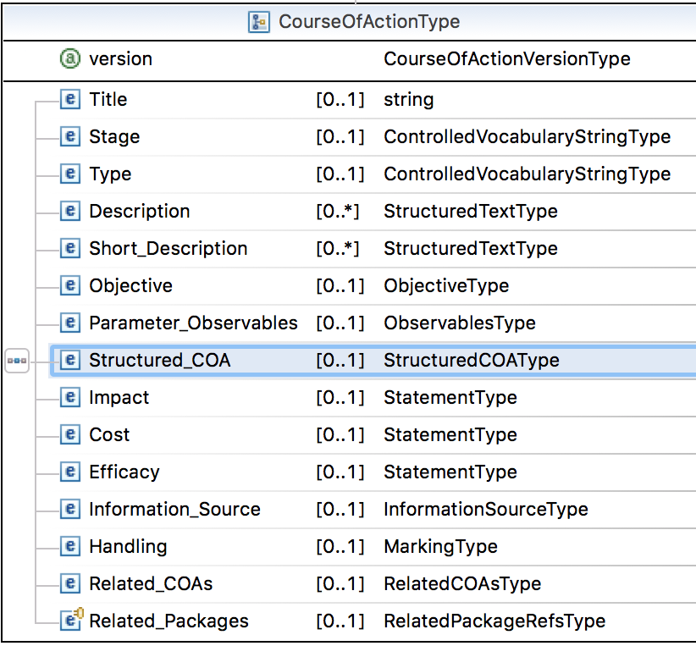
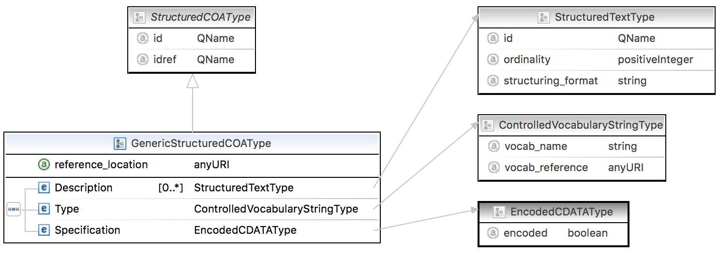
How to use OpenC2 with STIX today?
STIX 1.x – embed the OpenC2 message in the
Specification field as a String
STIX 2.0 – Use a custom object for OpenC2 and use in the course_of_action
object

Slide 59
Call to Arms
We need your help to make OpenC2 supported by STIX
If you are already a member
Please voice your opinion on email and slack channels
To become a member or join slack …

Slide 60
What is the next REALLY Hard Problem
Group Discussion

Slide 61
The Next Really Hard Problem
Actuator OpenC2 Profiles
Implementation Considerations
Reference Implementations
Define External Dependencies
Message Fabric
Engage Standards Bodies
BLUF: Articulate Six Month Roadmap

Slide 62
The Next Really Hard Problems?
Actuator OpenC2 Profiles
SDN Profile in Draft
Expand Use Cases
Other Actuator Types?
Implementation Considerations Document?
Sequence Numbering, Acknowledgement, Responses
Capture Lessons Learned; schemas
Reference Implementations Binary Encoding?
IoT Prototype Implementation?
Alert/ Response
Which Standards Body?
Leverage Pre-existing Relationships (e.g., STIX)
Determine what standards body (e.g., OASIS ) will require to stand up a subcommittee
Message Fabric?

Slide 63
OASIS Overview
Bret Jordan, BlueCoat

Slide 64
Path to Standardization
Group Discussion

Slide 65
UNCLASSIFIED
OpenC2 Standardization Timeline
FY
Q1 16
Q2 16
Q3 16
Q4 16
Q1 17
Q2 17
OpenC2 Definition
WG Definition Containers
STIX COA
Workflows
Message Fabric
External Dependencies
Data Models
Actuator (e.g., OpenC2, SACM)
Target (CyBox)
Language Description Document
Actions, Syntax
Use Cases
Gaps in language and data models
Reference Implementations (exercise/stretch the language)
Usage Scenarios
Pub/Sub, Perimeter Defense
Software Defined Network
COTS-based SHORTSTOP
Full Mesh, Sensors
Internet of Things
GitHub Repository
Reference Code
OpenC2 Connectors
Data Model Encoding and Translation Tools
OpenC2 Connectors
Adoption
(vendor and mission buy-in)
Vendor
Orchestrators
Actuators
OpenC2 Connectors
Native Support
Early Adopters
Cisco Threat INTEL API (CTIA), TCS
Standard (Revs)
Standards Bodies
NIST National CyberSecurity COE (OpenC2 Reference Design)
Socialization and Onboarding
Submit Draft Language Description Document to OASIS or other recognized Standards Body
UNCLASSIFIED

Slide 66
Documentation in Process
OpenC2 Language Description Document Ver. 1.0
Currently posted on Public Facing Website
Solicit comments from nonmembers
Comment Resolution circa January 2017
IA Considerations Document Ver. 1.0
Currently posted on Public Facing Website
Comments/ resolution from nonmembers?
Schema
JSON Schema Currently posted on GitHub
ASN.1 in Progress on Private GitHub Repository

Slide 67
Data Modeling/ STIX
STIX COA WG
OpenC2 to be included in STIX 2.XJan 2017
Cybox3.0 Data Model for STIX 2.0 Structured COA Field
Data Modeling
Flat Data Model
JSON Schema in process (pending)
ASN.1 Model in process (circa Feb. 2017)
YANG Model
Actuator Data Modeling Issues

Slide 68
Transition to Reference Implementations
Summarize Lessons Learned
Expand Use Cases
Make Prototype Implementations Readily Available
Address External Dependencies in Reference Implementations (e.g., message fabric, IA considerations)
Incorporate Findings Into the Documentation
Outreach to NCCOE?
Many Thanks to the Members for their Contributions to the Prototyping Efforts

Slide 69
Way Forward for OpenC2
Group Discussion

Slide 70
Questions? Comments? Complaints?

